Slide 1

North America Toll-Free Numbers​
2026
Navigating SMS and Voice – from start to launch​

Slide 2
Here's what we'll cover:
What's a Toll-Free Number?​
The key players​
Acquiring your Toll-Free Number​
Voice: setup and best practices​
Messaging: setup and best practices​
Messaging rules and regulations​
FAQs and final checklist​

Slide 3

What's a Toll-Free Number?
Chapter 1

Slide 4
What is a TFN?
Let's find the right fit for your business.
A Toll-Free Number uses a national prefix — like 888 or 877 — instead of a local area code. Your customers call and text you for free because your business picks up the tab. Simple, professional, and built for North America.*
Key features:
Voice and messaging in one: One number for calls and texts between the
US and Canada.
Nationwide reach: One number reaches your customers wherever they are
in the US, Canada, and the Caribbean. (See NANP slide.)
Cost control: Limit calls and texts from specific areas to manage your budget.
Free for your customers: No worries, no charges — just easy access to you.
High throughput: Start sending up to 10 messages per second right away,
with higher speeds available when you need them.
Types of Toll-Free Number:
Random:
We’ll instantly assign you a random TFN. It’s the fastest, most cost-effective way to get a functional number for things like internal ops
where a custom number isn’t a must-have.
(844) 847-4624 = (844) 84-SINCH
Vanity:
Pick a number that spells out a word or phrase that’s easy for customers to remember. Vanity numbers are great marketing tools that boost ad response rates and build brand recognition.
*Callers on mobile may still have airtime charges if they're not on an unlimited plan.

Slide 5
Toll-Free prefixes (8XX)
The prefix is the "area code" for a TFN. Though they all behave identically, the prefixes aren't interchangeable — your customers need to dial the exact one assigned to you.
Toll-Free Prefix | Status | Notes
800 | Original since 1967 | First and most recognized Toll-Free prefix introduced by AT&T*
888 | Added since 1996 | Added when 800 numbers started running out
877 | Added since 1998 | Another expansion of Toll-Free service
866 | Added since 1999 | Meets growing demand
855 | Added since 2010 | FCC-driven expansion
844 | Added since 2013 | Continual growth
833 | Added since 2017 | The newest Toll-Free prefix available today
*New 800 numbers are nearly impossible to get. You won't find them through us, but third-party brokers sometimes have them

Slide 6
Why Use a Toll-Free Number?
One number. Two channels. The benefits and use cases of a TFN:
Voice services
A single number for voice and messaging that reaches the US and CA ★
Give your customers a free, easy way to call.
Build a professional brand with a single number across the US and Canada.
And if you want something truly memorable? Go vanity.
Messaging services
Reach customers on their favorite channel — SMS boasts a 98% open rate.
Send alerts, reminders, and campaigns at scale.
Go beyond text with MMS to share images and media.
Top use cases:
Notifications and alerts
Order confirmations, appointment reminders, system or emergency alerts.
Two-Factor Authentication (2FA)
Secure logins with one-time codes.
Marketing and promotions
Personalized offers and product announcements, sent at scale.
Customer Care and support
Ticket updates, answers, support — all in one place.

Slide 7

The North American Numbering Plan (NANP)
One number that works across an entire continent.
What is the North American Numbering Plan (NANP)?
The NANP is a shared phone system covering 20+ countries across North America and the Caribbean.
All numbers follow a simple 10-digit format — no country codes needed when calling or texting within
the region.
Why is it relevant for Toll-Free Numbers?
That means your TFN works seamlessly wherever your customers are in the NANP.
No complicated formatting, no extra steps. One number connects you to everyone.
How It Works
Calling or texting within the NANP? Dial directly. Done.
Calling or texting outside the NANP? Toll-Free Numbers don't work outside the NANP.
For international reach, businesses typically offer separate, non-toll-free international numbers.
Countries and Territories in the NANP:
United States
Canada
American Samoa
Anguilla
Antigua and Barbuda
Bahamas
Barbados
Bermuda
British Virgin Islands
Cayman Islands
Dominica
Dominican Republic
Grenada
Guam
Jamaica
Montserrat
Northern Mariana Islands
Puerto Rico
Sain Kitts and Nevis
Saint Lucia
Saint Vincent and the Grenadines
Trinidad and Tobago
Turks and Caicos Islands
U.S. Virgin Islands
Find more information about the NANP

Slide 8
Fees and Billing
Simple, transparent pricing.
Leasing
Acquiring your TFN starts right in the Sinch Dashboard:
Numbers → Get virtual numbers → Toll Free → (optional) Search for a vanity number → Buy
Every TFN you lease from us is automatically set up for voice and messaging — but you'll need to activate each feature before it works. Chapters 4 and 5 walk you through both.
Fees
*Please check with your account manager for voice-specific rates.
Number Fees | Price (USD) | Carrier Pass Through | Price (Community Article)
Lease | $2 set up/$2 MRC* | US SMS | $0.003 USD (Avg)
Hosting | $0.50 set up/$0.50 MRC* | US MMS | $0.007 USD (Avg)
Registration | No Charge | CA SMS | $0.009 CAD (Avg)
MRC stands for Monthly Recurring Cost |  | CA MMS | $0.022 CAD (Avg)
Billing type: Standard Rated (STD)
The customer experience for receiving messages via TFN operate similarly to messages received via short codes or long codes & are included in their standard mobile plan. Perfect for everything from marketing to customer support.​

Slide 9
Launch expectations
Here's your realistic timeline to go live.
Best practices for frictionless launch,
avoid the following:​
Incorrect or mismatched info in your submission
Number was not hosted or ported to Sinch
Complex use cases that need extra compliance review
Missing documents (ex. signed Letter of Authorization)
A "freeze" on your account with your current provider*
High volume of submissions across the industry
And the #1 reason: a non-compliant campaign submission that needs edits before it's approved
The best way to avoid delays? Get it right the first time. We're here to help.
*A RespOrg change moves your voice service —
success depends on an accurate submission and
your current provider's cooperation.
1.
Get a TFN (buy, host, or port)
Buy, host, or port your number
How long it takes: Minutes (buy) or ~3 business days (host/port)
3.
TFN supplier review
Final review from our supplier
How long it takes: ~5 business days
2.
Brand and campaign verification
Our team reviews your submission
How long it takes: ~1 week
4.
Go live!
Launch in 1–2 weeks total

Slide 10

The key players
Chapter 2

Slide 11




Who's who in the Toll-Free world
Getting a TFN up and running takes a few players working together behind the scenes. Here's the lineup:
SOMOS:
Somos is a global provider of telephone number and identity information services; it oversees all North American telephone numbers and the assignment and administration of Toll-Free Numbers.
Mobile Network Operator (MNO):
An MNO (Mobile Network Operator) is the mobile operator who provides connectivity to end users. Tier 1 carriers in the US include AT&T, T-Mobile,
and Verizon. In Canada, Bell, Rogers, and Telus.
Brands:
Business entity using the Toll-Free Number to communicate directly with customers/subscribers.
Sinch Voice team:
We work with all of these players to get your number, set it up for voice and messaging, and make sure your use cases get verified.

Slide 12

Acquiring your
Toll-Free Number
Chapter 3

Slide 13
Three ways to get your TFN
Three ways to get started. You just need to pick yours.
Which path is right for you?
Buy a new number
The fastest path. Get a brand-new, voice-and-messaging-ready TFN in minutes —
right from the Sinch dashboard.
Host your number (Messaging only)
Already have a number you love? Hosting lets you use Sinch for text messaging while your voice service stays with your current provider. No disruption, just better messaging.
Port your number (Voice & Messaging)
Want everything under one roof? Porting (also called a RespOrg change) moves your entire number — voice and messaging — to Sinch. One provider, one number, zero hassle.
Heads up: You need to buy, host, or port your number with Sinch *before* you can submit a TFN messaging campaign for verification. Submit for a number that isn't with us yet and it'll be denied.
Not sure what to do? Let's figure it out!
Do you already have a Toll-Free Number?
Yes, I currently have a TFN with another provider.
No, I need a new one.
Port your TFN
To move both voice and messaging to Sinch, you’ll port your Toll-Free Number
Host your TFN
To move only your messaging to Sinch, you’ll host your Toll-Free Number
Buy a Number
Purchase a brand-new TFN in minutes, right from the Sinch dashboard.

Slide 14
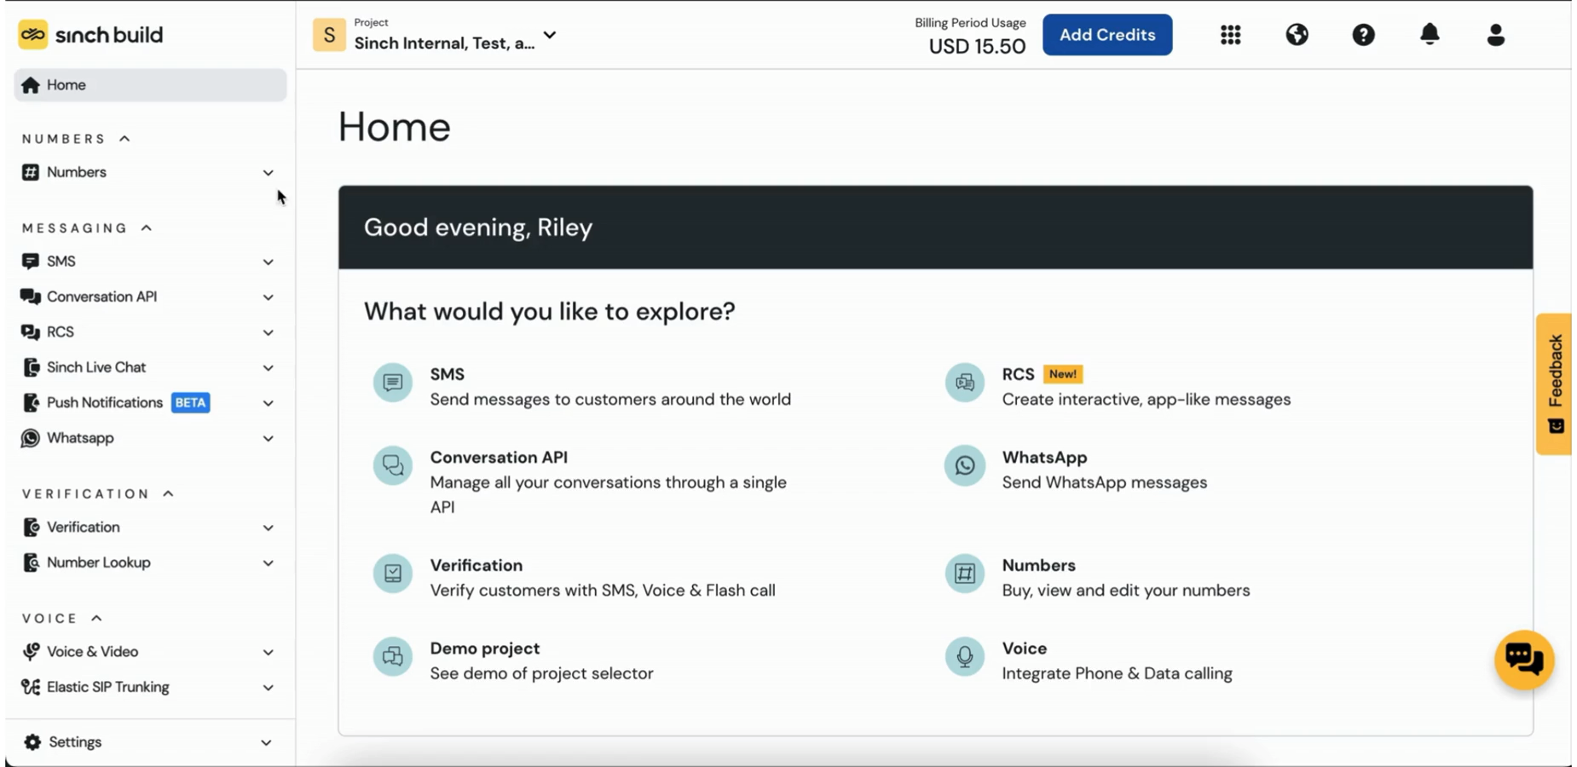
How to buy a TFN
Buying a new Toll-Free Number on Sinch Build
Log into the Sinch Dashboard → Numbers → Get virtual numbers
Select "United States" as your country*
Select "Toll-Free" under "Type"
Search for a custom or vanity number using "starts with" or "ends with" filters —
or skip this if any number works
You can select capabilities (Any, Voice, or SMS), but any TFN you lease from us is automatically set up for both voice and messaging
Choose your Toll-Free Number and click ’Buy' on the right-hand side
Click 'Get Number' in the pop-up
That's it — your number is purchased!
Key links and resources:
Toll-Free Numbers – Sinch.com
Buying a number from Sinch Sinch Community
Watch the demo:
*NOTE: you must view US inventory to see available Toll-Free Numbers

Slide 15
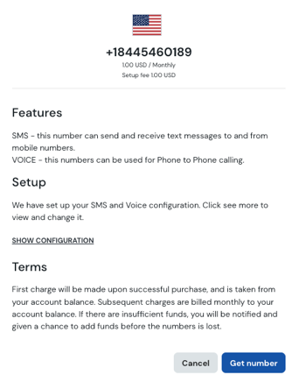
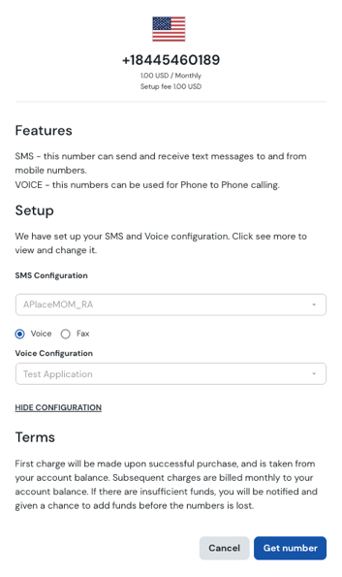
Key: Enable voice while buying a TFN
Pro tip: Activate your TFN voice capabilities while you're buying your number with one extra step
Between steps 5 and 6, you'll get the chance to link your number to your voice service. Do it then and your number is activated for voice instantly.
5. Choose your desired Toll-Free Number and click ’Buy' on the right-hand side
    5a. Click ‘Show Configuration’ in the pop-up
    5b. Choose your voice application: Voice API or Fax services*
    5c. Select the right configuration for your chosen option
6. Click 'Get Number'
7. Done — your TFN is purchased and activated for voice.
*Some customers may also see "Elastic SIP Trunking"
5a.
5b.
5c.
6.

Slide 16
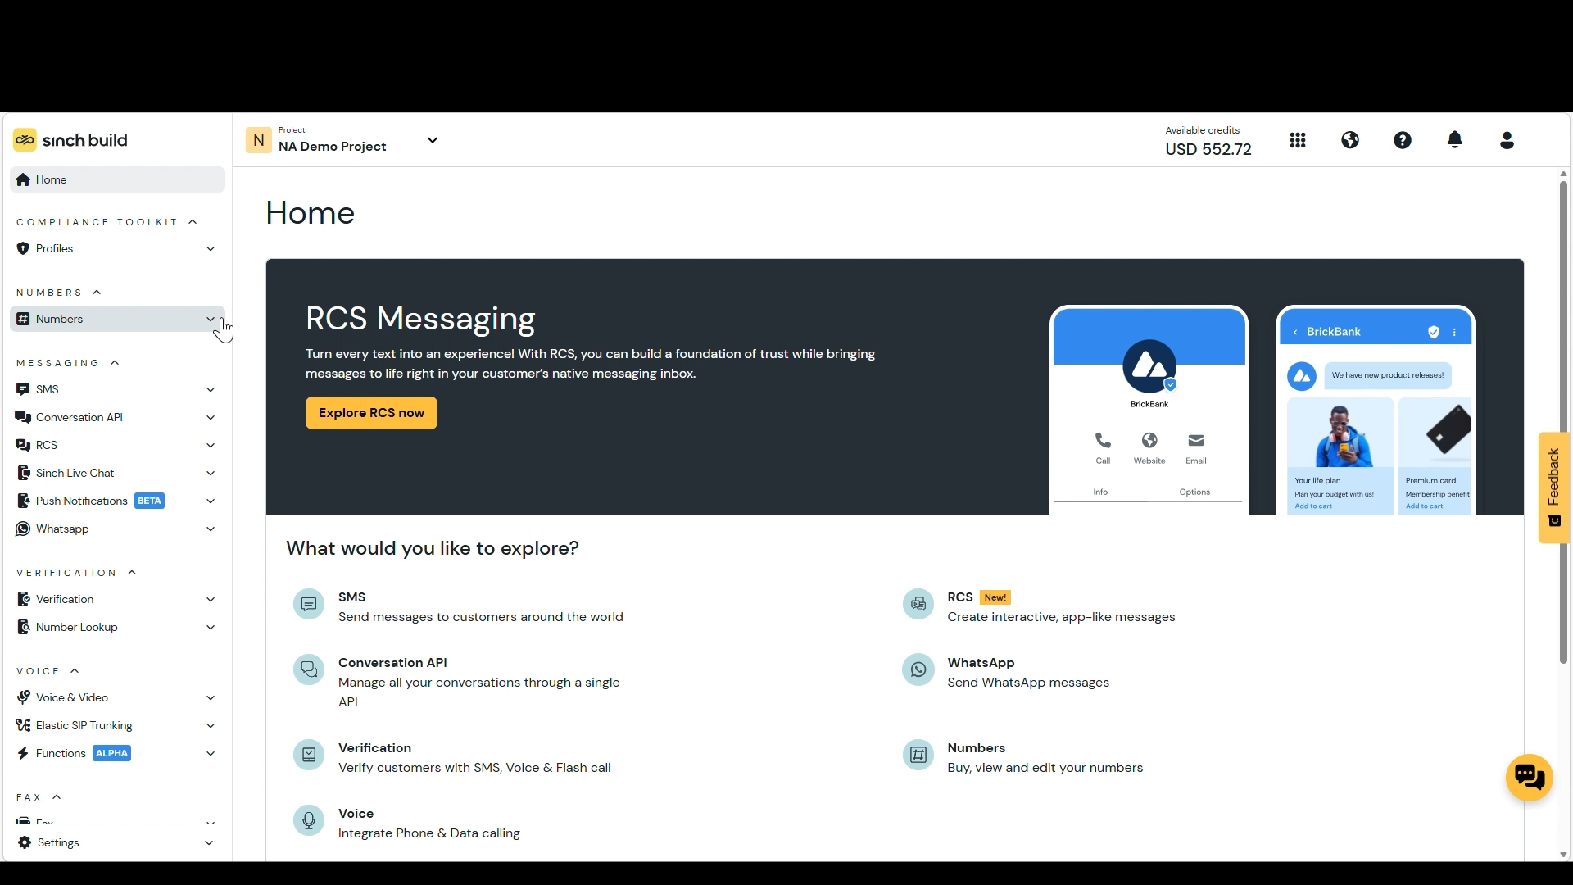
Key: Enable messaging when buying a TFN
The steps to SMS message-enable your purchased Toll-Free Number on Sinch Build
Log into the Sinch Dashboard → Numbers → Your virtual numbers
Select your Toll-Free Number under "Your numbers"
Click "Verify number" inside the blue banner to start the verification process
(this takes you to the Verified Sender Registration Form)
Complete the verification method that works best for you:
        Verified Sender Registration Form (VSF): online submission
        TFN Bulk Verification File: submit to your account manager
        Verification API: for developer-driven workflows
This creates a ticket for our team to review
Wait for your approval email — review and verification typically takes up to 5 business days
Once approved, your TFN is verified and ready to go!
Watch the demo:
Key links and resources:
CTIA Messaging Principles and Best Practices – Sinch Community
See Chapter 5: Messaging: setup and best practices

Slide 17
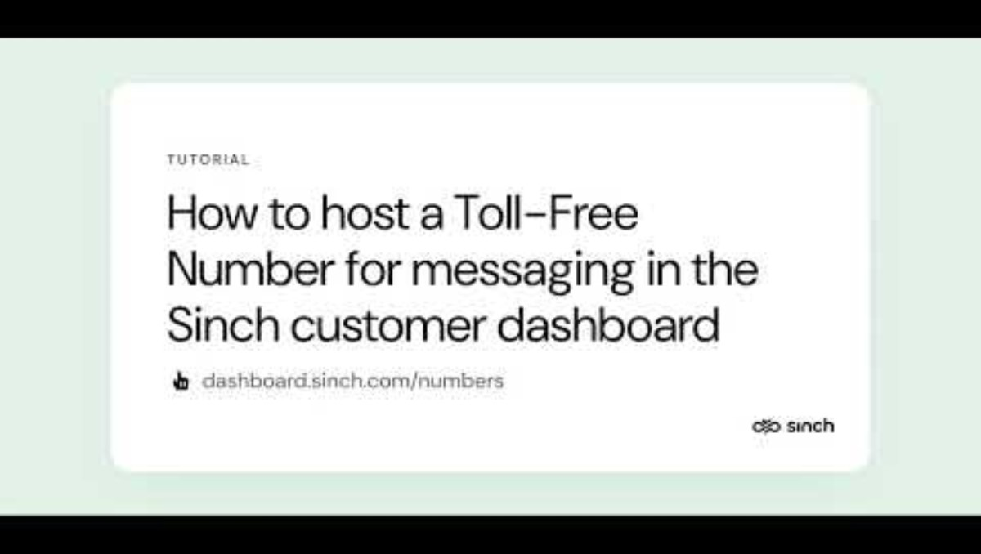
How to host a TFN
Moving messaging only to Sinch? Here's how hosting works.
To host a TFN with Sinch, you have to do two things:
Verify ownership: We'll verify the number is actually yours via a one-time passcode (OTP) or a recent invoice.
Verify your use case*: Tell us what you're sending and who you're sending it to before you go live.
*If you’ve already verified your use case with another provider, it remains verified and there’s no interruption to your messaging traffic. Best practice is to
re-verify with Sinch to keep your campaign record current and accurate with carriers.
Log into the Sinch Dashboard → Numbers → SMS hosting US/Canada
In the "Add numbers" dialog, enter the number(s) you want to host in E.164 format, separated by commas, and click "ADD”
Verify your ownership of your Toll-Free Numbers via OTP or Invoice, then click 'ENABLE SMS FOR NUMBERS’
      By OTP: A verification code is sent by voice call — best for a small batch (immediate)
    By Invoice: Email a current invoice (under 45 days old) to orders@sinch.com (takes 1–3 business days)
Select "Toll Free" from the Number Type dropdown.
Select the number(s) you want to text-enable and click 'NEXT'
Complete the Letter of Authorization (LOA) fields and click 'NEXT’,
then 'SUBMIT'
You'll get an email from DocuSign — review and sign it**
Once your signature is processed, you're ready to send SMS!
If a number fails hosting, you will see a "failed" status and can try the hosting
process again.
Watch the demo:
Key links and resources:
Hosting SMS Numbers for US and Canada Sinch Community
Managing your Hosted numbers
Sinch Community
**Can't find it? Check your spam folder

Slide 18
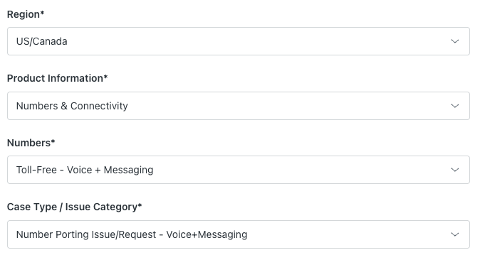
How to port a TFN
Moving both voice and messaging to Sinch? Here's how to port.
1. Fill out this Letter of Authorization (LOA) completely and accurately — every detail must exactly match what your current carrier has on file
2. Log into the Sinch Support Portal → Submit a request, and select
    Region: US/Canada
    Product information: Numbers & Connectivity
    Numbers: Toll-Free – Voice + Messaging
    Case Type: Number Porting Issue/Request – VOICE AND MESSAGING
    NOTE: Be sure to tell us your Account ID, Project ID and SMS Service API you intend to use when the number ports.
3. Your port request has been successfully submitted and the Sinch team will then provision this on your behalf
Key links and resources:
Sinch Letter of Authorization for Toll-Free Number Porting (US) Sinch Community
Sinch Support Portal

Slide 19
Using the Developer API
Buy, host, or port a TFN programmatically — no dashboard required.
Buy a number
Search available Toll-Free inventory and provision a number directly into your account via the Numbers API.
Developer Documentation:
Buy a Number
Host a number
Text-enable an existing TFN with Sinch — including ownership verification and LOA submission — without touching the dashboard.
Developer Documentation:
Host a Number
Port a number
Submit your port request, track its status, and get notified when it's live. All in code.
Developer Documentation:
Port a Number
Key things to know:
All three flows require an active Sinch account, a valid API key, and enough funds in your account to complete a purchase for the API process to function correctly.
Reminder: you must have your TFN verified by completing verification either in-dash, bulk file or via the Verification API to send messages via your TFN. See Slide 16
Not set up yet? Start at www.dashboard.sinch.com
All three flows require an active Sinch account and a valid API key. Not set up yet? Start at www.dashboard.sinch.com.

Slide 20

Voice: setup and best practices
Chapter 4

Slide 21
Reminder: The ways to enable Voice
A refresh on how to activate your TFN for voice- with or without messaging
Buying: Enabling voice when purchasing a TFN from Sinch
Log into the Sinch Dashboard → Numbers → Get virtual numbers
Select "United States" as your country
Select "Toll-Free" under "Type"
Choose your Toll-Free Number and click ’Buy' on the right-hand side
Click ‘Show Configuration’ in the pop-up
Choose your voice application
Select the right configuration for your chosen option
Click 'Get Number'
Done — your TFN is purchased and activated for voice
Porting: Moving voice and messaging from one provider to Sinch
Fill out this Letter of Authorization (LOA) completely and accurately — every detail must exactly match what your current carrier has on file
Log into the Sinch Support Portal → Submit a request and select:
        Region: US/Canada
        Product information: Numbers & Connectivity
        Numbers: Toll-Free – Voice + Messaging
        Case Type: Number Porting Issue/Request – VOICE AND MESSAGING
        NOTE: Be sure to tell us your Account ID, Project ID and SMS Service API you intend to use when the number ports.
Your port request has been successfully submitted and the Sinch team will then provision this on your behalf
*NOTE: To see in depth steps, review Chapter 3 “Getting your Toll-Free Number"

Slide 22
Inbound vs. Outbound calling
Know your use case before you dial in.
Inbound
This is when a customer calls you using your Toll-Free Number.
It's free for them — which encourages communication, builds satisfaction, and signals that you're a customer-first business.
Customer → Business
Best for:
Customer service and support hotlines
Sales inquiry lines
Order placement and tracking
Technical support
Outbound
This is when your business calls out and uses your TFN as the
caller ID. A familiar, trusted number boosts the chances customers will actually pick up the call.
Business → Customer
Best for:
Appointment reminders
Service and delivery notifications
Customer support follow-ups
Security verifications

Slide 23
Key: Controlling inbound calls
Your TFN is built for reach — but you're in control of where calls come from.
By default, you can receive calls from the US, Canada and all locations within the North American Numbering Plan (NANP), but you can block specific countries or territories within the NANP when it makes sense for your business.
Common reasons to restrict inbound calls:
Cost control: Block regions where you don't operate to avoid unwanted charges
Targeted service: Match your call reach to your actual service footprint
Fraud prevention: Block regions with known high levels of spam or fraud
To configure your inbound calling restrictions log into the Sinch Support Portal → Submit a request and select:
Region: US/Canada
Product information: Numbers & Connectivity
Numbers: Toll-Free – Voice
Case Type: Feature Request
Countries and Territories in the NANP:
United States
Canada
American Samoa
Anguilla
Antigua and Barbuda
Bahamas
Barbados
Bermuda
British Virgin Islands
Cayman Islands
Dominica
Dominican Republic
Grenada
Guam
Jamaica
Montserrat
Northern Mariana Islands
Puerto Rico
Sain Kitts and Nevis
Saint Lucia
Saint Vincent and the Grenadines
Trinidad and Tobago
Turks and Caicos Islands
U.S. Virgin Islands

Slide 24
Key: Register your TFN for outbound calling
Registration verifies your ownership and calling practices with major US carriers, and some Canadian carriers. Dramatically reduce the chances of your calls being flagged as 'Spam' or 'Scam Likely'
Why it matters:
Better answer rates: Customers trust verified numbers
Brand protection: Stop your number from being tied to fraudulent activity
Avoid call blocking: High-volume unregistered numbers often get blocked automatically
NOTE: If your actual calling behavior doesn't match your registered use case, your TFN can be re-marked as spam.
Step 1: Register for CNAM:
Go to the Sinch Support Portal → Submit a request
        Region: US/Canada
        Product information: Numbers & Connectivity
        Numbers: Number feature (MACD)
        Case Type: CNAM/Caller Name Presentation
Review for accuracy and click Submit
Our team submits your info to the national database and notifies you when it's done
Step 2: Register with analytics providers:
Use the Free Caller Registry website to register your numbers with major analytics providers (First Orion, Hiya, TNS) and confirm your calls are legitimate. It’s recommended you also register directly through the carriers with these links:
First Orion, HIYA*, TNS*, and Neustar
      *Currently the Free Caller Registry and First Orion is only available for TFNs registered in the United States. TFNs registered with a Canadian business address should register with HIYA and TNS directly.
For an advanced walkthrough on Spam Mislabeling visit the Sinch Community Article step-by-step guide

Slide 25
Key: Post-registration spam risks
Registration is the first step — but keep your calling behavior clean. Even a registered number can get flagged as "spam" or "spam likely". Here's what to watch out for:
Aggressive calling behavior:
A high volume of calls in a short window can look like robocalling — even when it's not. The network watches call patterns closely.
Use case drift:
Registered for "customer support callbacks" but sending marketing promotions? Analytics providers will catch the mismatch and put your number in the penalty box.
Individual handset blocking:
This is different from a carrier spam flag. A user can always block any number on their personal device — that's their choice, and it sits outside the registration process entirely.
If you do get flagged:
Work directly with the third-party analytics providers linked in the previous slide to resolve it and review your outbound patterns to make sure they still align with your registered use case.

Slide 26
TFN voice best practices
Five habits that keep your calls clean and your reputation strong.
Build a strong Know Your Customer (KYC) policy
The best defense against spam labels is a solid KYC framework, including
a clear policy for how you monitor and prevent unwanted calls leaving your system. Bad actors are increasingly targeting enterprise and wholesale providers without strong monitoring. Don't be an easy target.
Sign calls with your own certificate
Analytics companies are starting to group calling behavior by provider
and signing credentials. If someone else is signing your calls — even with
an "A" attestation — your legitimate traffic can get lumped in with theirs.
Your own certificate lets analytics providers and carriers see your specific
calling patterns.
Stay compliant with regulations
Follow the TCPA, FTC telemarketing rules, and any applicable state
regulations. Scrub your termination numbers against the Do Not Call List
and the Reassigned Number Database. Meet all Do Not Originate requirements.
Don't test each new number
It seems logical, but testing every new TFN backfires. Analytics providers see high fraud activity from numbers that make only a few calls before moving on — and that first call often triggers a spam flag.
Build good calling patterns early
Reputation is earned, not given. Establish consistent, expected traffic patterns
from the start. Avoid repeated calls to the same number over a short window,
and don't call outside normal business hours.
Key links:
FTC: Unwanted Calls, Emails, and Texts
FTC: The Do Not Call Registry
FTC: Robocall mitigation policy

Slide 27

Messaging: setup and best practices
Chapter 5

Slide 28
What is Toll-Free verification?
Getting your Toll-Free Number use case approved and trusted by carriers
What is Toll-Free Verification?
Think of verification as the campaign registration process for your Toll-Free Number — the same way Short Code and 10DLC require campaign registration before you can start sending, TFNs need to go through verification first. It's a straightforward registration process where we work with carriers to confirm your business is legitimate. It's an industry-wide requirement, and it's what keeps business messaging a safe, trusted channel for everyone.
Why it matters:
You protect your customers (and your brand): Verification proves your messages come from a real, legitimate business — yours. It shuts out spammers and builds long-term trust with your audience.
You get better deliverability: Carriers treat verified numbers as trustworthy. Your messages are far less likely to be filtered or blocked — so they reach your customers every time.
You build a solid reputation: Verification shows you're a government-authorized business committed to sending valuable content. It proves you're one of the good guys. And that's always good for business.

Slide 29
Key: What you’ll need for verification
Have these ready before you submit — it'll save you time.
Your Business Registration Number (BRN)
This is your business's official government ID — sometimes called a Tax ID.
It confirms you're a registered, legitimate business.
Required as of January 2026.
  US-Based organizations:
Provide your Employer Identification Number (EIN). The legal business name you submit must exactly match the name tied to your EIN. No EIN? Your submission will go through additional checks, and approval isn't guaranteed.
Organizations outside the US:
Provide your official business registration number from your country's government, along with your legal business name and the issuing authority.
Political Campaign Verify (CV) Token
All 527 political organizations must get a valid CV token before submitting.
It proves your campaign is a legitimate political entity.
Required as of February 2026.
  How to get yours:
Register at www.campaignverify.org — it's free, and you can generate tokens for Toll-Free, 10DLC, and Short Code campaigns all at once
Include your token in your verification submission or give it to your account manager
Visit the Business Registration Number community article for an in-depth breakdown of this submission formatting by country

Slide 30
Key: What you’ll need for verification
Have these ready before you submit — it'll save you time.
Terms & Conditions
This is your program's rulebook — it tells customers what they signed up for and protects you if something goes wrong. It confirms your messaging program is transparent and compliant. Required as of September 2026.
Best Practices:
Keep it complete: Cover your program name, message frequency, and what kind of messages you send.
State the disclosures: Include "Message and data rates may apply" verbatim, plus a note that carriers aren't liable for delayed or undelivered messages.
Make opt-out easy: Spell out STOP, END, CANCEL, UNSUBSCRIBE, and QUIT, alongside a working support contact.
Link your Privacy Policy: Keep it near your Call-to-Action, never buried in a pop-up or footer.
No T&Cs? Your submission will be rejected outright starting September 15, 2026.
Requirements
Program or brand name
Program description
Message and data rates may apply disclosure
Message frequency (or recurring message disclosure)
Customer support contact information
Complete opt-out instructions (HELP and STOP)
Link to the privacy policy
Disclosure that states “Carriers are not liable for any delayed or undelivered messages”
All required disclosures that are present at opt-in
The terms and conditions link also needs to be present on the opt-in page when using a web form.

Slide 31
Key: What you’ll need for verification
Have these ready before you submit — it'll save you time.
Privacy Policy
This is your program's data promise — it tells customers what you collect and how you protect it. It confirms your messaging program respects consumer privacy. Required as of September 2026.
Best Practices:
Explain your data use: State clearly what consumer data you collect and how it's used.
Protect opt-in data: Include a clause confirming mobile opt-in consent won't be shared with third parties or affiliates for marketing.
Never sell or rent consent: Don't sell, rent, transfer, or share opt-in data, and don't message anyone from a list you didn't collect yourself.
Keep it accessible: Link it clearly near your Call-to-Action, and make sure it's live and public, not hidden behind a login or dead link.
No Privacy Policy? Your submission will be rejected outright: September 2026.
Requirements
What data you collect and how it’s used
A statement that mobile information and opt-in consent won’t be shared with third parties or affiliates for marketing or promotional purposes

Slide 32
How to launch your messaging campaign
You've got your number. Now there's one more step before you can send: verification.
You can do it yourself in the Sinch dashboard, or work with your account manager.
★ The preferred method - Self-Serve via Sinch Build. The dashboard and Developer API make it straightforward.
START
Step 1
Step 2
Step 3
Step 4
Step 5
Step 6
END
A customer wants to create a Toll-Free Number (TFN) messaging campaign
You sign in to the Sinch Dashboard.
You get a TFN by choosing to buy, host, or port.
You submit verification to Sinch Team for review
We review it. Our team does a quick compliance check and will let you know if anything needs fixing.
We get final approval. We send the final info to our supplier for their green light.
You'll get an email as soon as the TFN supplier approves your campaign.
Campaign is
Live!
Want a hand? Your Account Manager (AM) can guide you through the process and submit on your behalf.
START
Step 1
Step 2
Step 3
Step 4
Step 5
END
A customer wants to create a Toll-Free Number (TFN) messaging campaign
You send your info. You’ll give your completed verification method* to your Account Manager (AM).
Your AM
coordinates with
Sinch team to
review submission​
We review it. Our team does a compliance check and works with you and your AM to fix anything if needed.
We get final approval from our supplier.
Your AM will let you know as soon as your TFN is verified, tested, and ready to go.
Campaign is
Live!
*You can use the Verified Sender Registration Form for one or a few numbers, or the Bulk Verification Spreadsheet for larger portfolios.

Slide 33
Reminder: The ways to enable Messaging
A refresh on how to activate your TFN for messaging when purchasing, with voice services, or on its own
Buying: Enabling messaging when purchasing a TFN from Sinch
Log into the Sinch Dashboard → Numbers → Your virtual numbers
      Select your Toll-Free Number under
      "Your numbers”
      Click "Verify number”
Complete the verification method that works best for you:
      Verified Sender Registration Form (VSF):
      online submission
      Bulk Verification file: submit to your
      account manager
      Verification API: for developer-driven workflows
Wait for your approval email. Once approved, your TFN is verified and ready to go!
Porting: Moving voice and messaging from one provider to Sinch
Fill out this Letter of Authorization (LOA)
Log into the Sinch Support Portal → Submit a request and select:
    Region: US/Canada
    Product information: Numbers & Connectivity
    Numbers: Toll-Free – Voice + Messaging
    Case Type: Number Porting Issue/Request – VOICE AND MESSAGING
    NOTE: Be sure to tell us your Account ID, Project ID and SMS Service API you intend to use when the number ports.
Your port request has been successfully submitted and the Sinch team will then provision this on your behalf.
Hosting: Moving only messaging from one provider to Sinch
Prerequisites: Verify ownership and use case
Log into the Sinch Dashboard → Numbers → SMS hosting US/Canada → "Add numbers"
Verify your ownership of your Toll-Free Numbers via OTP or Invoice
Select "Toll Free" from the Number Type dropdown.
Select the number(s) you want to text-enable and click and complete LOA fields
Review and sign the email you receive from DocuSign
Once your signature is processed, you're ready to send SMS!
*NOTE: To see in depth steps, review Chapter 3 “Getting your Toll-Free Number"

Slide 34
Three ways to get verified
Ready to verify? Pick the path that works for you.
Verified Sender Registration Form (VSF)
Our straightforward web form. Tell us about your brand, use case, and customer consent method.
Rejected? See why in in your initial ORDERS ticket
Best for:
One number, or just a handful — and you want a simple, manual process
Links and documents:
Verified Sender Registration Form (VSF)
Toll-Free Bulk Verification
Have a lot of numbers? Submit them all at once using a single spreadsheet.
Rejected? See why in in your initial ORDERS ticket
Best for:
Managing a large portfolio without filling out individual forms.
Links and documents:
Bulk Verification Spreadsheet Template
Submit the completed file to your account representative or email it to orders@sinch.com if you already have your Toll-Free Number at Sinch
Toll-Free Verification API
Build verification directly into your own software or platform.
Rejected? Email to orders@sinch.com
Best for:
Businesses that need to register numbers programmatically, in real time, or at high volume.
Links and documents:
Developer Documentation: TFN Verification API

Slide 35
TFN messaging best practices
Seven habits that keep your campaigns running smoothly.
Skip public URL shorteners
Bit.ly and TinyURL are red flags for carriers. Use a custom, branded shortener instead.
Brand every message
Always include your business name — it's the simplest way to avoid spam filters.
Use double Opt-in
A two-step confirmation confirms customers actually want to hear from you.
Get explicit consent
Never message someone who hasn't given you clear, documented permission.
Support HELP/STOP commands
Make it easy for customers to get help or unsubscribe — it's required, and it's the right thing to do.
Include Terms & Conditions and Privacy Policy
Link both clearly near your opt-in and CTA. Make sure they're live, public, and match what you submit for verification.
Use one number
Spreading messages across multiple TFNs is a carrier red flag. Stick with one.
Set clear expectations
Tell customers how often they'll hear from you. Fewer surprises means fewer
opt-outs.

Slide 36

Messaging rules and regulations
Chapter 6

Slide 37
Disallowed content
To ensure a trusted messaging ecosystem, the following content categories are strictly forbidden and violating these rules can lead to your Toll-Free number being blocked
Category | Forbidden Content Includes
High-Risk Financial Services | Payday loans, short-term high-interest loans, auto/mortgage/student loans, third-party lending, stock alerts and cryptocurrency.
Gambling and Sweepstakes​ | Casino apps, sports betting, contests, rebates, 50/50 raffles, giveaways, instant win games (spin-to-win wheel) or other prize awards​
"Get Rich Quick" Schemes | Work-from-home programs, risk investment opportunities, and multi-level marketing.
Third-Party Debt Collection | Debt consolidation, debt reduction, and credit repair programs. Note: TFN may be considered for 1st party collections only with express written consent in the United States ONLY. In Canada there is no TFN collections traffic, 1st party or otherwise.
Illegal and Controlled Substances | Content related to federally illegal drugs (including cannabis), and prescription drugs.
Lead Generation and Third-Party Marketing | Selling or sharing customer opt-in data with third parties. You may only send marketing from your own brand.
Job Postings | Third party job boards Note: TFN may be considered if the first party job brand is the one doing the hiring.
Deceptive Content | Phishing, spoofing, fraud, or deceptive marketing.
*Click here for the expanded notes on A2P Disallowed Content

Slide 38
Disallowed content (cont.)
The "SHAFT" categories (Sex, Hate, Alcohol, Firearms, and Tobacco) have specific sending rules, especially concerning age-gating.
SHAFT Category | Restriction on Toll-Free Numbers
Sex and Hate | Strictly prohibited (includes pornographic, sexually explicit, profane, or hate speech content).
Firearms | Not allowed (includes content related to the sale of guns, other weapons, fireworks or explosives).
Tobacco and Vaping | Not allowed.
Indirect Alcohol Promotion (US Exception) | Allowed only to US destinations, and ONLY if proper age-gate mechanisms are in place
Direct Alcohol Promotion | Not allowed.
Proper Age-Gating Requirements:
Requirement | Description
Proper Age Gate | The user must enter their full date of birth (Day, Month, Year) at opt-in.
Insufficient Method | A simple "Are you over 21?" checkbox is not sufficient.
Canada Restriction | Age-gated content of any kind is not allowed on Toll-Free numbers sent to Canadian destinations.
*Click here for the expanded notes on A2P Disallowed Content

Slide 39
Rules and regulations
Must-dos for your Toll-Free Messaging campaign
Call to Action (CTA)
All US Toll-Free messaging programs are required to include a Call to Action.
This is the way you advertise the program to potential users and gain consent to send messages. A call to action may be presented verbally (i.e. at point of sale), via print ad (i.e. text JOIN to 8XX-XXX-XXXX), or via web (i.e. mobile number entry form).
Call-To-Action must be market ready.
Your call to action must include
Clear program description (e.g. Get updates about our sales and promotions!)
“Message and data rates may apply” disclosure
Link to Terms and Conditions
Link to Privacy Policy
Message frequency (#msgs/mo, msg frequency varies, recurring messages, etc)*
Opt-out instructions (Reply STOP to end)*
HELP instructions (Reply HELP for help)
*A CTA is still required for one-time transactional campaigns, but message frequency and opt-out instructions are optional
HELP instruction is optional if it is communicated in the Terms and Conditions

Slide 40
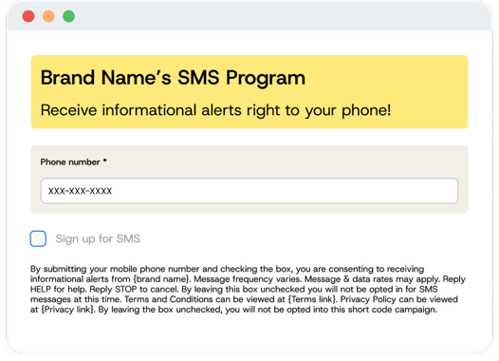

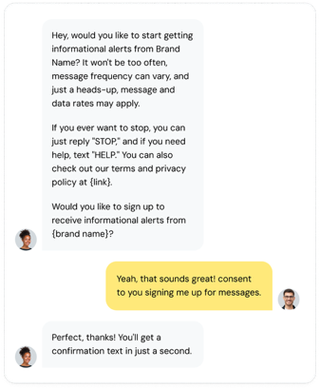
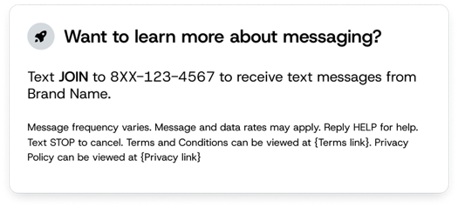

Call to Action (CTA) examples
Recurring message program examples
Keyword
Web
Verbal
{Brand Logo}
Text {keyword} to 8XX-XXX-XXXX to receive {type of alerts} from {brand name}. Message frequency varies. Message and data rates may apply. Reply HELP for help. Reply STOP to cancel. {Terms and Conditions link} and {Privacy Policy link}
▢ By submitting your mobile phone number and checking the box, you are consenting to receiving {type of alerts} from {brand name}. Message frequency varies. Message and data rates may apply. Reply HELP for help. Reply STOP to cancel. {Terms and Conditions link} and {Privacy Policy link}. By leaving the box unchecked, you will not be opted into this Toll-Free messaging campaign..
Would you like to receive {type of alerts} from {brand name}? {Message Frequency}. Message frequency varies. Message and data rates may apply. Reply STOP to end. Terms and Conditions and Privacy Policy can be found here: {link}. Would you like to sign up to receive {type of alert} from {brand name}?

Slide 41
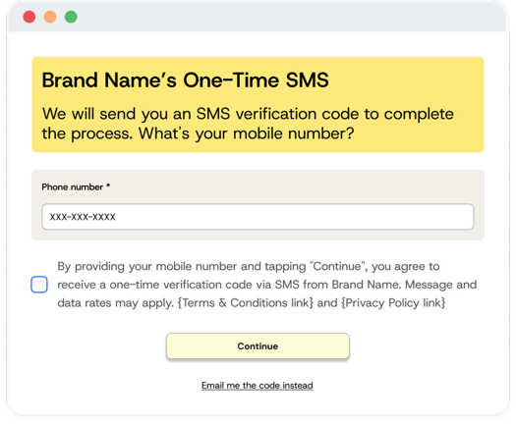
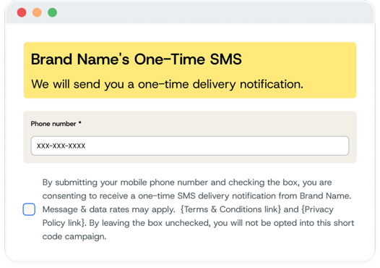
Call to Action (CTA) examples
One-time program (OTP) examples
Keyword
{Brand Logo}
We will send you an SMS verification code to complete the process. What's your mobile number?
[Phone Number field]
By providing your mobile number and tapping "Continue", you agree to receive a one-time verification code via SMS from Sinch. Message and data rates may apply. {Terms and Conditions link} and {Privacy Policy link}
[Continue button]/[Email me the code instead]
One-Time Alert
▢ By submitting your mobile phone number and checking the box, you are consenting to receive a one-time SMS delivery notification from {brand name}. Message and data rates may apply. {Terms and Conditions link} and {Privacy Policy link}. By leaving the box unchecked, you will not be opted into this Toll-Free messaging campaign.

Slide 42
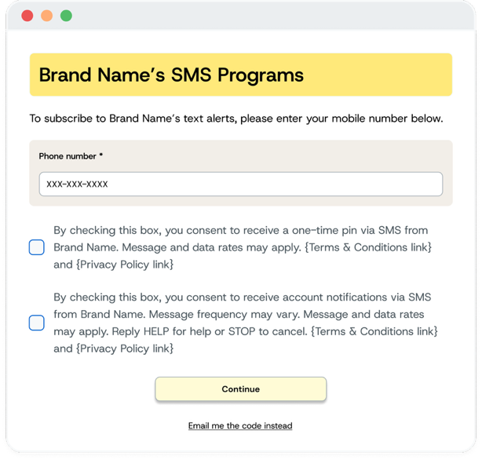
Call to Action (CTA) examples
Multiple use cases, with one being an OTP (one-time program/Pin) example
Multiple use cases, with one being OTP
To subscribe to {brand name} text alerts, please enter your mobile number below.
[Phone number field]
▢ By checking this box, you consent to receive a one-time pin via SMS from {brand name}. Message and data rates may apply. {Terms and Conditions link} and {Privacy Policy link}
▢ By checking this box, you consent to receive account notifications via SMS from {brand name}. Message frequency may vary. Message and data rates may apply. Reply HELP for help or STOP to cancel. {Terms and Conditions link} and {Privacy Policy link}
[Continue]
[Email me the code instead]

Slide 43
Rules and regulations
Must-dos for your Toll-Free Messaging campaign
STOP keyword to Opt-Out
The STOP keyword is a mandatory, network-managed feature that allows mobile subscribers to easily opt out of receiving text messages. This process is handled automatically at the carrier network layer to ensure universal compliance with telecommunication regulations.
What Triggers a Network Opt-Out?
It is critical to understand that the network-level block is only triggered when the keyword STOP is sent as the sole content of the message. It is NOT case sensitive, but it must be the only word in the text.
Note: VALID: STOP, stop, Stop, stoP vs. INVALID: "Stop texting me” or “Stop it!”
The Opt-Out Process:
A subscriber texts STOP (or the French equivalent, ARRET) to a Toll-Free Number.
The carrier network automatically intercepts the message and sends a standardized confirmation reply
(see table below).
All subsequent attempts to send messages from that Toll-Free Number to that subscriber will be blocked by the network and will fail with an error code of 1110 “User Opted Out (STOP)”.
Sinch forwards the original STOP message to you for your awareness. Upon receiving this message, you are required to remove that subscriber from your campaign and contact lists to ensure full compliance and prevent failed message attempts.
Language Equivalents and Network Responses
Language | Keyword | Network Message
English | STOP | "NETWORK MSG: You replied with the word "stop" which blocks all texts sent from this number. Text back "unstop" or "start" to receive messages again."
French (Canada) | ARRET (STOP) | "MSG RÉSEAU: Vous avez répondu avec le mot "ARRET" qui bloque tous les textes envoyés à partir de ce numéro. Renvoyer le message "NONARRET" pour recevoir à nouveau les messages."

Slide 44

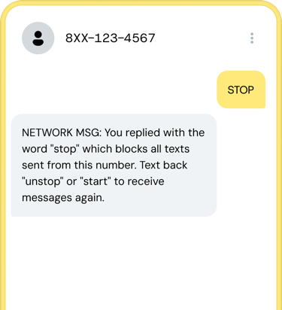
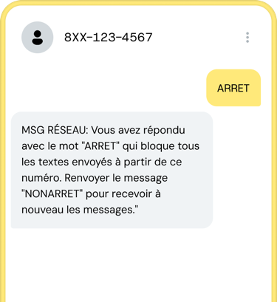
STOP keyword examples
English and French
STOP keyword to Opt-Out English
NETWORK MSG: You replied with the word "stop" which blocks all texts sent from this number. Text back "unstop" or "start" to receive messages again.
ARRET keyword to Opt-Out French
"MSG RÉSEAU: Vous avez répondu avec le mot "ARRET”qui bloque tous les text esenvoyés à
partir de ce numéro. Renvoyer le message
"NONARRET" pour recevoir à nouveau les messages."

Slide 45
Rules and regulations
Must-dos for your Toll-Free Messaging campaign
UNSTOP/START keywords to opt back in
Subscribers who have previously opted out can easily opt back in to a messaging campaign using the network-managed UNSTOP/START keywords.
How it works:
User Action: A previously opted-out subscriber texts UNSTOP or START to the same Toll-Free Number.
Automatic Opt-In: The network recognizes these keywords and automatically removes the block, allowing the subscriber to receive messages again from that number.
Client Notification: Sinch forwards the UNSTOP or START message to your account, signaling the user's renewed consent.
Canadian French-Language Equivalent:
The keyword NONARRET (Unstop) triggers the same opt-in process.
Language | Keyword | Network Message
English | UNSTOP or START | NETWORK MSG: You have replied "UNSTOP" and will begin receiving messages again from this number. NETWORK MSG: You have replied "START" and will begin receiving messages again from this number.”
French | NONARRET | "MSG RÉSEAU: Vous avez répondu "NONARRET" et recommencer à recevoir des messages de ce numéro."
NOTE: Keyword requirements are largely the same as Canadian Short Codes, with the addition of French-language equivalents. Any other keywords/auto responses (including HELP or AIDE) need to be managed
by the client.

Slide 46
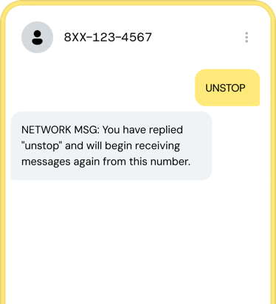
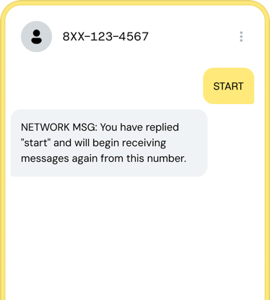
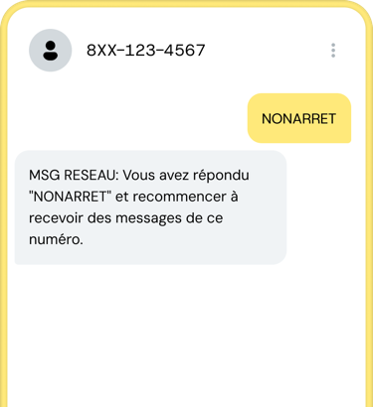
UNSTOP/START keyword examples
English and French
UNSTOP keyword English
NETWORK MSG: You have replied "unstop" and will begin receiving messages again from this number.
START keyword English
NETWORK MSG: You have replied "start" and will begin receiving messages again from this number.
NONARRET keyword French
Vous avez répondu "NONARRET" et recommencer à recevoir des messages
de ce numéro.

Slide 47
Rules and regulations
Must-dos for your Toll-Free Messaging campaign
HELP/AIDE keywords for customer support
Subscribers can request assistance from your brand by using the HELP/AIDE keywords.
How it works:
User Action: A subscriber texts HELP or AIDE to the Toll-Free Number.
Automatic Opt-In: Unlike network-managed keywords like STOP or UNSTOP, you are responsible for configuring and sending the response to HELP/AIDE messages.
Required Information: Your automated response must include your brand/program name and customer
care contact information (e.g., a support phone number, email address, or website).
Canadian French-Language Equivalent:
The keyword AIDE (Help) triggers the same process and should generate a similar response in French.
Language | Keyword | Example Message
English | HELP | Sinch Alerts: For help call (844)-847-4624, or email support@sinch.com.
French | AIDE | Offres Sinch: Pour obtenir de l'aide, appelez le (844)-847-4624, ou envoyez un courriel à support@sinch.com.
NOTE: It is your responsibility to manage all HELP/AIDE keyword responses. The network does not handle these automatically.

Slide 48

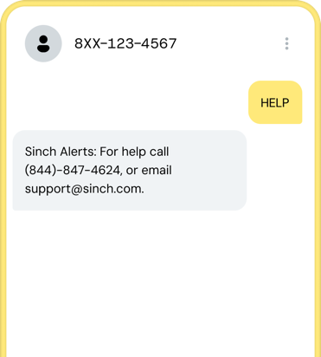
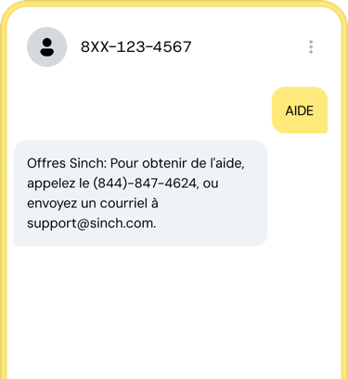
HELP keyword examples
English and French
HELP keyword to Opt-Out English
Sinch Alerts: For help call (844)-847-4624, or email support@sinch.com.
AIDE keyword to Opt-Out French
“Offres Sinch: Pour obtenir de l'aide, appelez le (844)-847-4624, ou envoyez un courriel à support@sinch.com.”

Slide 49
Message flow
The order of your messages matter. Here’s how to create a message
flow that meets requirements.
If you’re running a recurring program, you must send a message when a new customer opts in. This is called the opt-in confirmation message, or sometimes referred to as a welcome message. It's the first message that is sent to your customer confirming to them they've opted into your program. Your brand also needs to respond to HELP and opt-out keywords (STOP, QUIT, CANCEL, END, and UNSUBSCRIBE) whether your Toll-Free messaging program is recurring or one-time.
Message response requirements:
1
1
1
Opt-in message
Program/brand name*
Message frequency (i.e. Msg freq. may vary)
“Message and data rates may apply”
Customer care information (i.e. Reply HELP for help)
Opt-out instructions (i.e. Reply STOP to end)
*Brand name is the only requirement for one-time programs
Help response
Program/brand name
Contact info (email/phone/support web page)
Opt-out message
Program/brand name
Confirmation that user has unsubscribed and will not receive any more messages

Slide 50
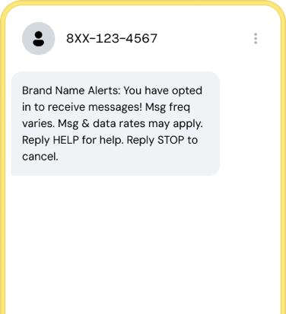
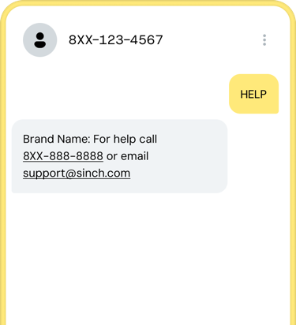
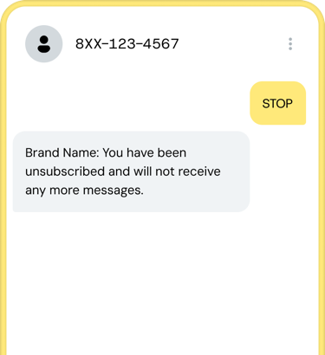
Message flow examples
A Toll-Free message flow that meets requirements
Recurring program Opt-In confirmation message
{Brand name} alerts: You have opted in to receive messages! Msg freq varies. Msg and data rates may apply. Reply HELP for help. Reply STOP to cancel.
Help response
{Brand name}: For help call 8XX-XXX-XXXX or email example@example.com
Opt-out response
{Brand name}: You have been unsubscribed and will not receive any more messages.

Slide 51
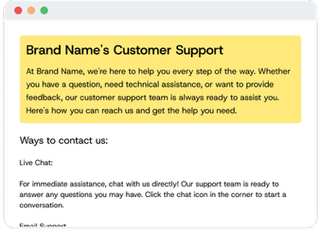
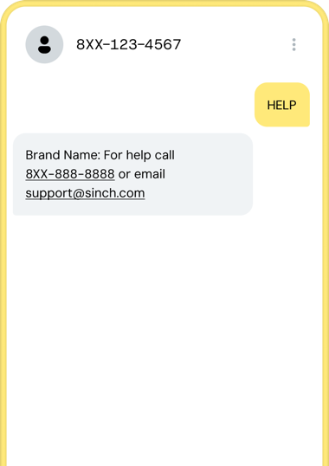

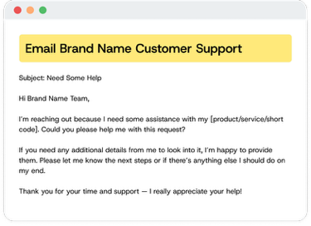
Rules and regulations
Want to get your Toll-Free Messaging campaign approved the first time? Follow these guidelines:
Terms and conditions
Your terms and conditions page will be checked for:
Program name and description
Message frequency
“Message and data rates may apply”*
Customer care contact information (reply HELP for help) and another form of customer support (phone number, email or a direct link to the customer support page)
Opt-out instructions (i.e. Reply STOP to end)
Link to Privacy Policy
*Terms and Conditions are required for all new TFN campaigns
Website for customer support page
Read the "Verification Compliance Guidance" community article
Phone call option
Reaching out via e-mail

Slide 52
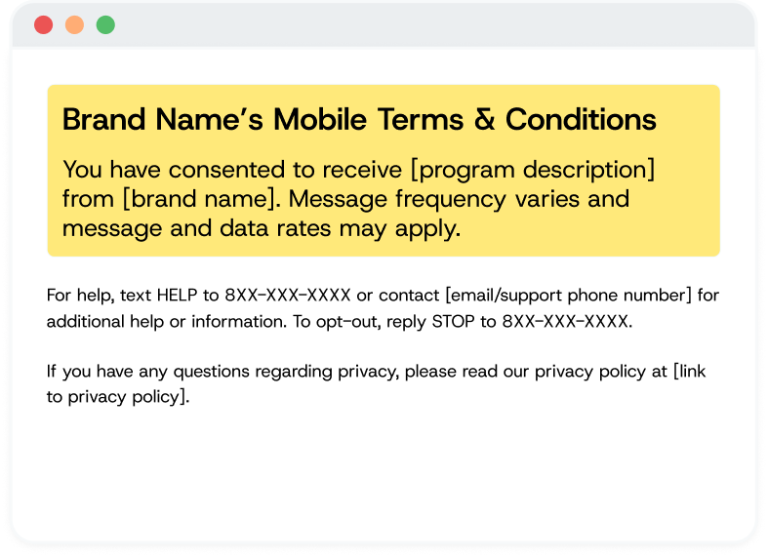
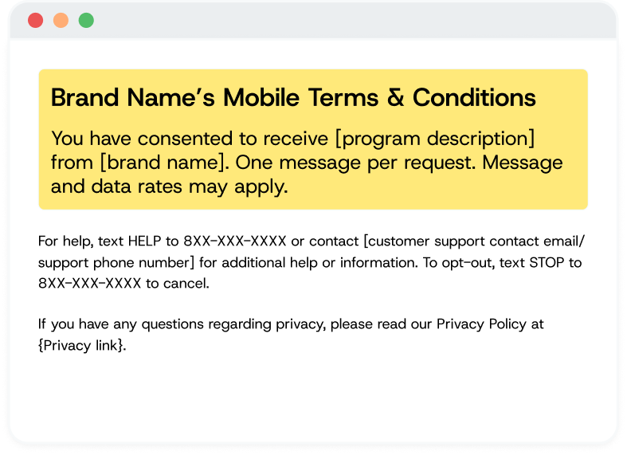
Terms and Conditions (T&C) examples
Recurring message and one-time program (OTP) examples
Recurring programs
[Brand Name] Terms and Conditions
[Program description]. Message frequency varies and message and data rates may apply. [Customer care contact information (reply HELP to 8XX-XXX-XXXX for help and another form of customer support)]. To opt out, reply STOP. For our privacy policy, see here: [link to privacy policy].
One-time programs
[Brand Name] Terms and Conditions
[Program description]. One message per request. Message and data rates may apply. [Customer care contact information (reply HELP to 8XX-XXX-XXXX for help and another form of customer support). For our privacy policy, see here: [link to privacy policy].

Slide 53

Rules and regulations
Privacy policy
It must be clear that the end user’s personal information will not be shared or sold to third parties for the purpose of marketing. In other words, only the brand that the user specifically provides consent to may send messages to that user. Lead generation is not permitted.
Note: Businesses that collect personal data must have a Privacy Policy under U.S. and Canadian privacy laws. Now legally required as of September 2026, having a Privacy Policy ensures transparency and compliance. It should be submitted and made easily accessible on its webpage.

Slide 54
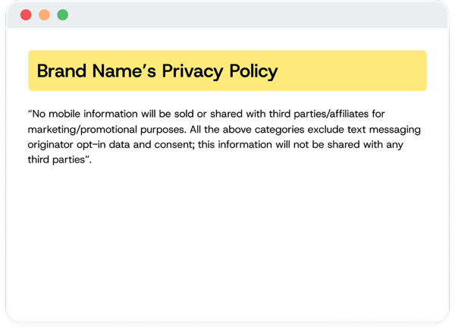
Privacy policy example
Privacy policy example via Web
Privacy policy
[Program/Brand Name] Privacy Policy
“No mobile information will be sold or shared with third parties/affiliates for marketing/promotional purposes. All the above categories exclude text messaging originator opt-in data and consent; this information will not be
shared with any third parties”.

Slide 55

FAQs and final checklist
Chapter 7

Slide 56
Frequently asked questions (FAQs)
Common questions about the TFN process
Does Sinch have a test TFN to try out?
    There are no shared TFNs available for testing. If you would like to test integration
    with Sinch, this can be done using Sinch's shared test short codes.
Does Voice and SMS need to be with the same provider?
    No, you can use a different Voice provider than your SMS provider on a TFN. You are not forced to get your voice and SMS services from the same company. Sinch can provide both Voice and SMS service, or you can choose to enable only SMS messaging with Sinch.
Why should a business use a TFN?
    Text-enable an existing, familiar business line, project a "national feel" rather than a local one, get up and running quickly (1-5 business days), use a single number for both the US and Canada, use a number that supports both voice and messaging, benefit from a registration process that is less complex than other options, and more.
What are the common use cases for TFNs?
    Common use cases include two-factor authentication (2FA), account notifications, delivery updates, appointment reminders, promotions, and customer service.
Can TFNs send MMS (multimedia messages)?
    Yes, TFNs support MMS in the U.S., Canada, and Puerto Rico.
What is the messaging speed (throughput) for a TFN?
    The default throughput is 10 messages per second (msg/sec). Higher throughput is available and can be approved on a case-by-case basis depending on the use case.
Are Privacy Policy links required?
    Businesses that collect personal data are generally required to have a Privacy Policy under U.S. and Canadian privacy laws. Even if not legally required in all cases, having a Privacy Policy is a best practice for transparency and compliance. If a business has one, it should be submitted and made easily accessible on its webpage.
Why are my TFN messages getting blocked?
    The most common reasons for blocked messages are:
        Error 255 (Spam): The carrier has flagged the traffic as spam due to high user complaints, a high opt-out rate, or the use of public URL shorteners.
        Error 64 (TFN Not Verified): The number has not completed the mandatory sender verification process.
        Error 205 (Illegal Subscriber): The number is not correctly provisioned for messaging. This may happen if the number was ported away or an issue occurred during setup.

Slide 57
Final Checklist
Double check that you’ve done everything right to submit your Toll-Free messaging campaign
Set up your Sinch Dashboard account
Decided whether you're buying, hosting, or porting your TFN
Enabled your TFN for voice and messaging
Submitted your campaign for verification
Reviewed the messaging best practices
Set up your required keywords (HELP and STOP)
YOU ARE ALL SET!
For more guidance, visit the Toll-Free Numbers section on the Sinch Community site.

Slide 58

Thank you!
Let's get you connected.
sales@sinch.com
www.sinch.com

